Slide 1


<Roshan Nikhil Martis>
<09/07/2025>

Slide 2

Outline
Executive Summary
Introduction
Methodology
Results
Conclusion
Appendix

Slide 3
Executive Summary
This analysis leverages several web and data technologies to perform both visual and statistical evaluations of Falcon 9 rocket launches. Using tools such as Python, SQL, Folium, Dash, and Seaborn, we explored historical SpaceX launch data obtained from the SpaceX API and Wikipedia. To predict launch and landing outcomes, we trained four machine learning models: Logistic Regression, Decision Tree Classifier, K-Nearest Neighbors (KNN), and Support Vector Machine (SVM). Among these, Logistic Regression, KNN, and SVM delivered the best performance, achieving an accuracy of approximately 84%. These models enhance our ability to anticipate the likelihood of a launch or landing failure with improved precision.

Slide 4
Introduction
Given the substantial financial investment involved in launching Falcon 9 and similar rockets, accurately predicting potential catastrophic failures can lead to considerable cost reductions.
Our goal is to determine the key factors that influence the likelihood of booster failure—either during launch or landing—so that we can better anticipate and mitigate such risks.

Slide 5

Section 1

Slide 6
Methodology
Executive Summary
Data collection methodology:
Combination of direct SpaceX API and webscrapingPerform data wrangling
Perform exploratory data analysis (EDA) using visualization and SQL
Perform interactive visual analytics using Folium and Plotly Dash
Perform predictive analysis using classification models
Normalize the data and perform four distinct predictive models including, logistic regression, KNN, SVM, and Decision Tree Classifier

Slide 7
Data Collection
Describe how data sets were collected.
You need to present your data collection process use key phrases and flowcharts

Slide 8
Data Collection – SpaceX API
Import library
https://github.com/rnmuzumaki/my-data-science-notebook
Request ad parse data using GET
Filter and include Falcon9
Clean the data using is null, replace etc

Slide 9
Data Collection - Scraping
Request falcon 9 from Wiki page
https://github.com/rnmuzumaki/my-data-science-notebook
Extract all columns
Crate Data frame

Slide 10
Data Wrangling
Describe how data were processed
Explore the dataset to uncover trends, derive initial insights, and identify potential patterns. Analyze the frequency of values using value_counts() to help determine which column could serve as the target variable for training supervised learning models.
You need to present your data wrangling process using key phrases and flowcharts
Add the GitHub URL of your completed data wrangling related notebooks, as an external reference and peer-review purpose
Calculate no launches
Cal no and occurence
Cal outcome per orbit type
Create a landing outcome

Slide 11
EDA with Data Visualization
Summarize what charts were plotted and why you used those charts
To examine numerical features, I use scatter plots to visualize potential relationships between them. For categorical variables, bar charts are more effective. These plots help in understanding how individual features correlate with success rates, and combining multiple features often reveals deeper insights.
Add the GitHub URL of your completed EDA with data visualization notebook, as an external reference and peer-review purpose

Slide 12
EDA with SQL
Using bullet point format, summarize the SQL queries you performed
1. Find unique launch sites used in missions
To identify all the different launch locations SpaceX has used, we retrieve the distinct values from the launch site column.
2. Get a few records where launch site starts with 'CCA'
We filter the dataset to include only those launch entries whose site names begin with “CCA” and display the first five such records.
3. Total payload carried for NASA (CRS) missions
By filtering for missions conducted on behalf of NASA under the CRS program, we calculate the total mass of all payloads carried by the boosters.
4. Average payload for booster type F9 v1.1
We determine the mean weight of payloads transported by the boosters categorized under the version “F9 v1.1”.
5. Earliest success on ground pad landing
To find out when SpaceX first successfully landed a booster on a ground pad, we look for the earliest date where the landing outcome indicates success on a ground platform.
6. Boosters successful on drone ships with medium payload
We extract the booster versions that had successful landings on drone ships and carried payloads ranging between 4000 kg and 6000 kg.
7. Count of successful vs failed missions
Here, we tally up how many missions ended in success and how many in failure based on the final mission status across all records.
8. Booster versions with highest payloads
Using a nested query, we first find the maximum payload weight and then identify which booster versions were used to carry it.
9. Drone ship failures in 2015
We focus on drone ship landings that failed during the year 2015 and list the corresponding launch sites and booster versions used.
10. Most frequent landing outcomes in a time range
Between June 2010 and March 2017, we count how often each type of landing result occurred and rank them from most to least common.

Slide 13
Build an Interactive Map with Folium
Summarize what map objects such as markers, circles, lines, etc. you created and added to a folium map
I created a Folium map centered on a location, added circles and markers for each launch site, and drew lines connecting them to a selected coast point.
Explain why you added those objects
In this module, we begin by mapping launch site locations and nearby areas using Folium. Then, we explore the interactive map to identify spatial patterns. Lastly, we interpret these patterns to suggest the most suitable launch site.
Add the GitHub URL of your completed interactive map with Folium map, as an external reference and peer-review purpose

Slide 14
Build a Dashboard with Plotly Dash
Summarize what plots/graphs and interactions you have added to a dashboard
Pie and scatter plots
Explain why you added those plots and interactions
I can use this interactive dashboard to identify the site with the most successful launches, determine which site has the highest success rate, and analyze which payload ranges have the lowest success rates.
Add the GitHub URL of your completed Plotly Dash lab, as an external reference and peer-review purpose

Slide 15
Predictive Analysis (Classification)
Summarize how you built, evaluated, improved, and found the best performing classification model
Explored and prepared the SpaceX launch data
Visualized key insights using charts and dashboards
Trained multiple machine learning models (Logistic Regression, SVM, Decision Tree, KNN)
Tuned hyperparameters using GridSearchCV for each model
Evaluated model accuracy using test data
Plotted confusion matrices for each classifier
elected the best-performing model based on accuracy results
Create coloumns
Clean and Std data
Split in to traing and test data
Find best best SVM for models
Find the method and build model using tests data

Slide 16
Results
Exploratory data analysis results
Launches to ES-L1, GEO, HEO, and SSO have shown the highest success rates.
Rockets targeting GTO have the lowest likelihood of returning successfully
Interactive analytics demo in screenshots
Predictive analysis results
Decision tree perform well

Slide 17

Section 2

Slide 18
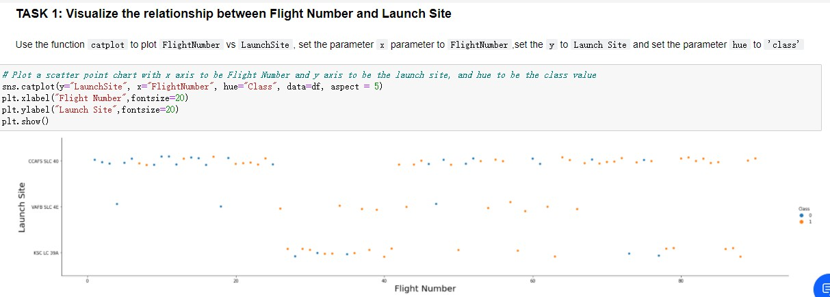
Flight Number vs. Launch Site
Show a scatter plot of Flight Number vs. Launch Site
Show the screenshot of the scatter plot with explanations
Higher flight numbers generally show improved success rates across all launch sites.
VAFB SLC-4E had better success between flight numbers 20 to 40.
CCAFS and KSC sites showed higher success in later flight attempts.

Slide 19
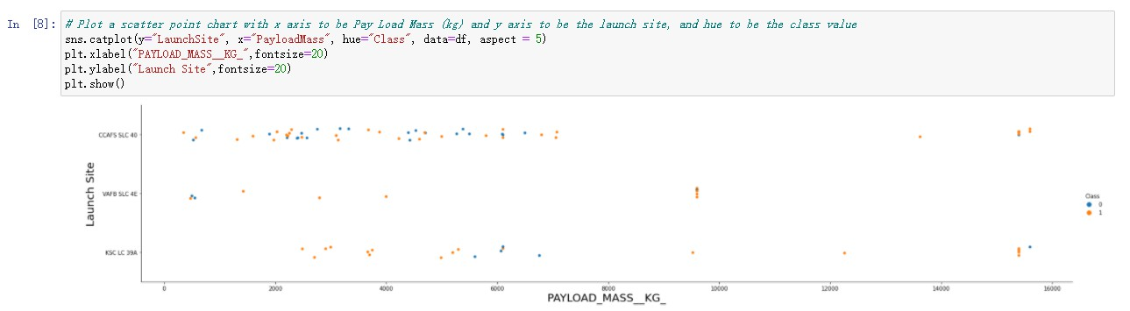
Payload vs. Launch Site
Show a scatter plot of Payload vs. Launch Site
Show the screenshot of the scatter plot with explanations
The VAFB SLC-4E site did not launch rockets with payloads over 10,000 kg.
Heavier payloads appear to reduce the chances of the rocket’s first stage returning.

Slide 20
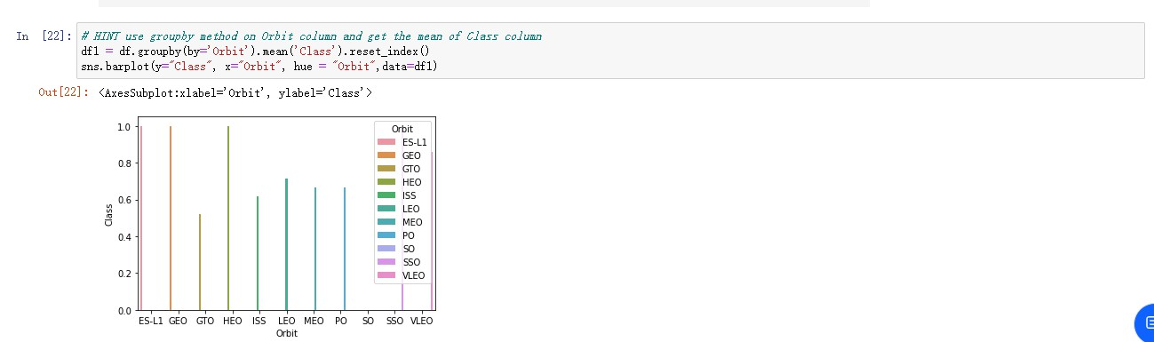
Success Rate vs. Orbit Type
Show a bar chart for the success rate of each orbit type
Show the screenshot of the scatter plot with explanations
From the plotted bar chart, we can see ES-L1, GEO, HEO, and SSO share the highest success rates, whereas the rockets launched in GTO seem unlikely to return.

Slide 21
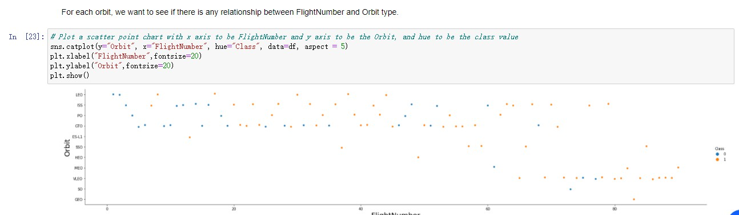
Flight Number vs. Orbit Type
Show a scatter point of Flight number vs. Orbit type
Show the screenshot of the scatter plot with explanations
In LEO orbit, more flights tend to result in higher success rates.
In GTO orbit, flight numbers don’t seem to affect the success rate.

Slide 22
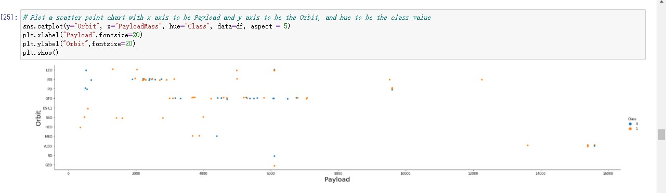
Payload vs. Orbit Type
Show a scatter point of payload vs. orbit type
Show the screenshot of the scatter plot with explanations
With heavy payloads the successful landing or positive landing rate
are more for Polar,LEO and ISS.
However for GTO we cannot distinguish this well as both positive landing rate and negative landing(unsuccessful mission) are both there here.

Slide 23
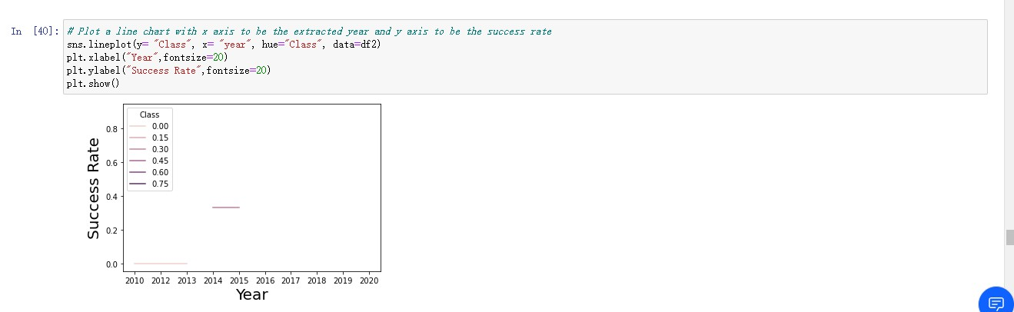
Launch Success Yearly Trend
Show a line chart of yearly average success rate
Show the screenshot of the scatter plot with explanations
Success rate increases from 2013 to 2020

Slide 24
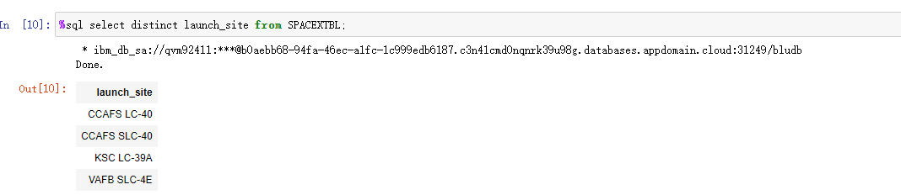
All Launch Site Names
Find the names of the unique launch sites
Present your query result with a short explanation here

Slide 25
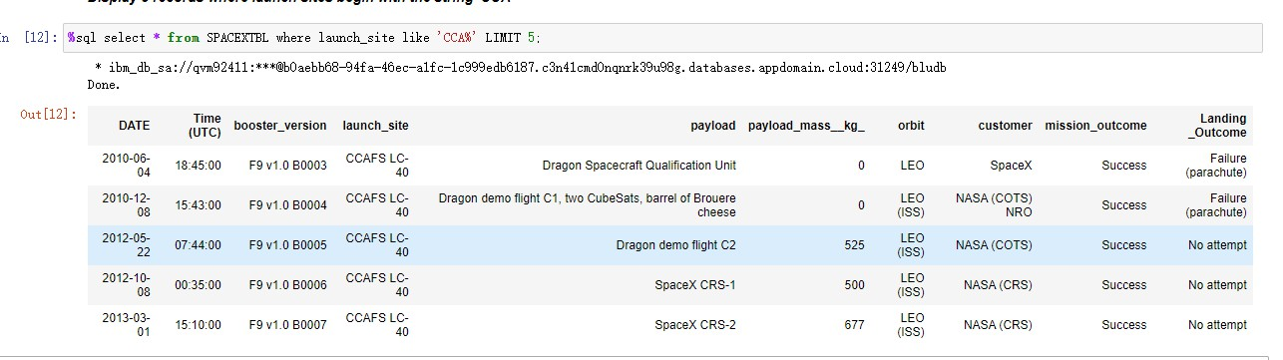
Launch Site Names Begin with 'CCA'
Find 5 records where launch sites begin with `CCA`
Present your query result with a short explanation here

Slide 26
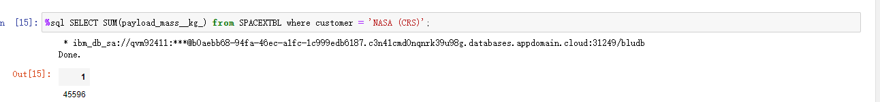
Total Payload Mass
Calculate the total payload carried by boosters from NASA
Present your query result with a short explanation here

Slide 27
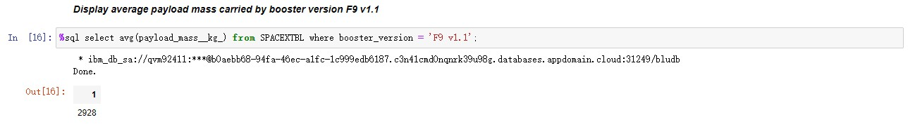
Average Payload Mass by F9 v1.1
Calculate the average payload mass carried by booster version F9 v1.1
Present your query result with a short explanation here

Slide 28
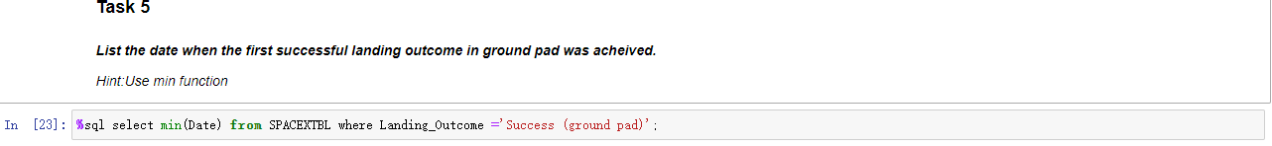
First Successful Ground Landing Date
Find the dates of the first successful landing outcome on ground pad
Present your query result with a short explanation here

Slide 29
Successful Drone Ship Landing with Payload between 4000 and 6000
List the names of boosters which have successfully landed on drone ship and had payload mass greater than 4000 but less than 6000
Present your query result with a short explanation here
JCSAT-14, JCSAT-16 , SES-10 , SES-11 / EchoStar 105

Slide 30
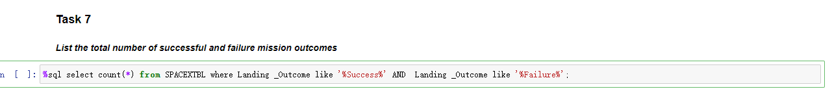
Total Number of Successful and Failure Mission Outcomes
Calculate the total number of successful and failure mission outcomes
Present your query result with a short explanation here
71

Slide 31
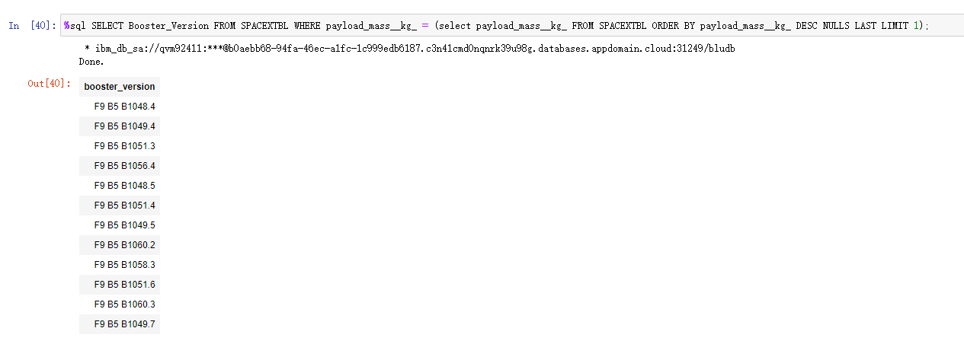
Boosters Carried Maximum Payload
List the names of the booster which have carried the maximum payload mass
Present your query result with a short explanation here

Slide 32
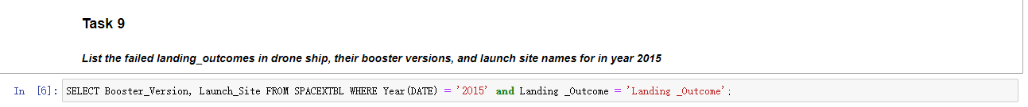
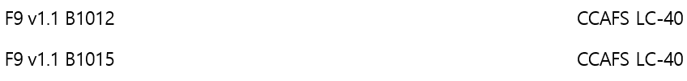
2015 Launch Records
List the failed landing_outcomes in drone ship, their booster versions, and launch site names for in year 2015
Present your query result with a short explanation here

Slide 33
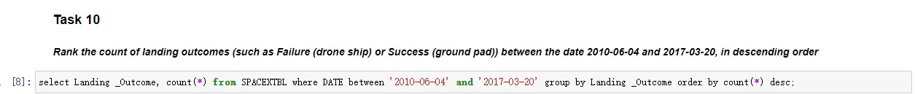
Rank Landing Outcomes Between 2010-06-04 and 2017-03-20
Rank the count of landing outcomes (such as Failure (drone ship) or Success (ground pad)) between the date 2010-06-04 and 2017-03-20, in descending order
Present your query result with a short explanation here

Slide 34

Section 3

Slide 35
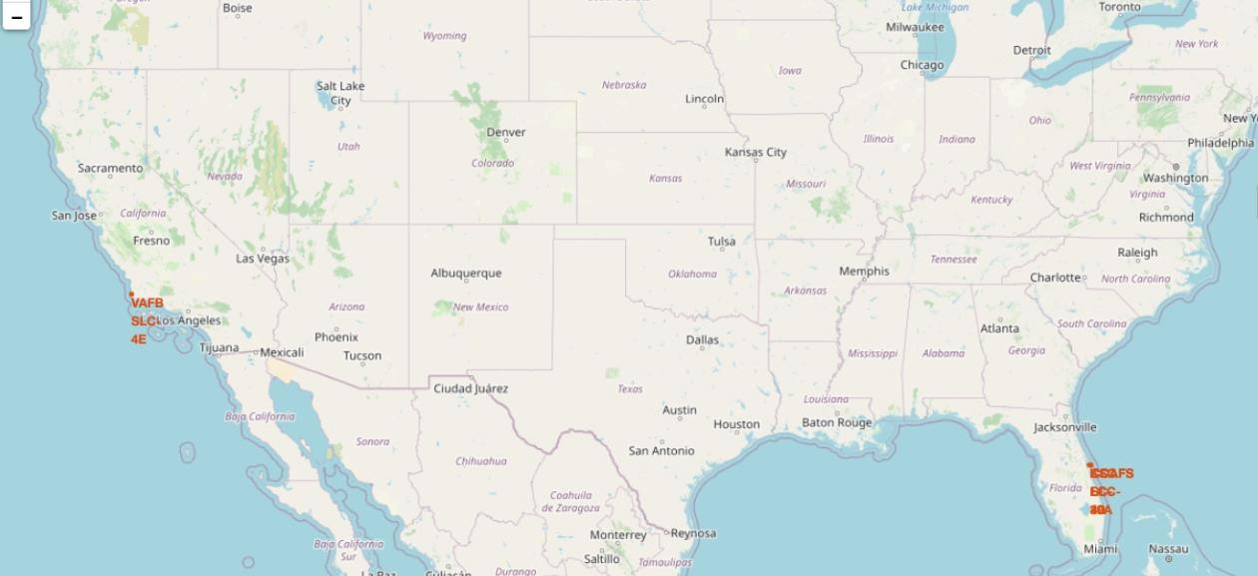
Launch Sites Markers
Replace <Folium map screenshot 1> title with an appropriate title
Explore the generated folium map and make a proper screenshot to include all launch sites’ location markers on a global ma

Slide 36
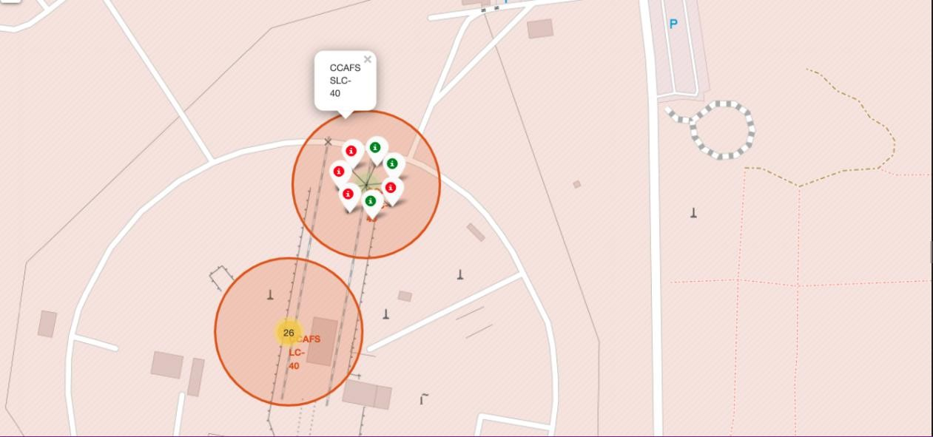
Mark the Success/Failed Launches for Each Site on the Map
Replace <Folium map screenshot 2> title with an appropriate title
Explore the folium map and make a proper screenshot to show the color-labeled launch outcomes on the map
Explain the important elements and findings on the screenshot
The color-coded markers show that CCAFS SLC-40 launch site has a relatively high success rate compared to others.

Slide 37
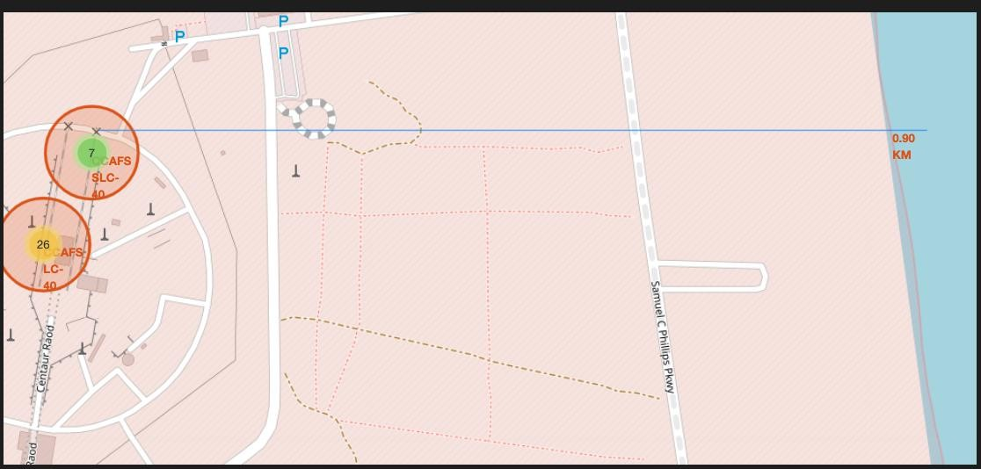
Calculate the distances between a launch site to its proximities
Replace <Folium map screenshot 3> title with an appropriate title
Explore the generated folium map and show the screenshot of a selected launch site to its proximities such as railway, highway, coastline, with distance calculated and displayed
Explain the important
Launch sites are located near railways for easy transportation of equipment.
They are also close to highways for logistical convenience.
Proximity to coastlines supports safe rocket trajectory and recovery.
Sites are placed away from cities to ensure safety during launches.

Slide 38

Section 4

Slide 39
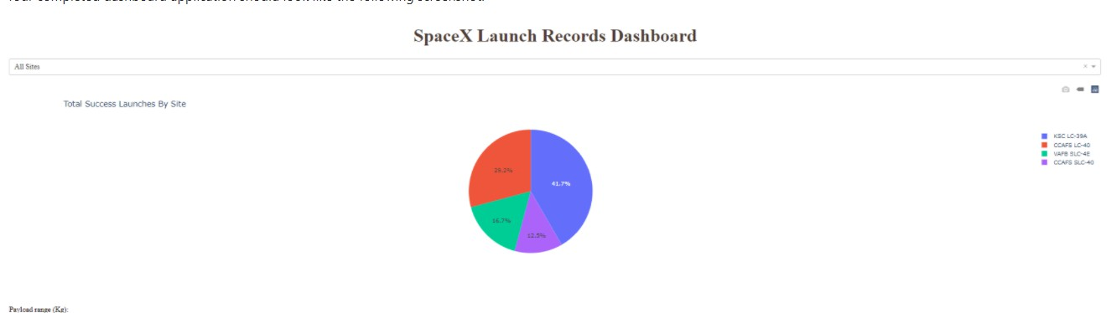
SpaceX Launch Records Dashboard
Replace <Dashboard screenshot 1> title with an appropriate title
Show the screenshot of launch success count for all sites, in a piechart
Explain the important elements and findings on the screenshot
KSC LC-39A accounts for the highest number of successful launches.
It has shown consistent performance over multiple missions.
This makes it one of the most reliable SpaceX launch sites.

Slide 40
The Launch site with highest launch success ratio
Replace <Dashboard screenshot 2> title with an appropriate title
Show the screenshot of the piechart for the launch site with highest launch success ratio
Explain the important elements and findings on the CCAFS SLC-40

Slide 41
Correlation between payload and success for all sites
Replace <Dashboard screenshot 3> title with an appropriate title
Show screenshots of Payload vs. Launch Outcome scatter plot for all sites, with different payload selected in the range slider
Explain the important elements and findings on the screenshot,

Slide 42

Section 5

Slide 43
Classification Accuracy
Visualize the built model accuracy for all built classification models, in a bar chart
Find which model has the highest classification accuracy
Decision tree classifier has the highest classification accuracy with 90.36%

Slide 44
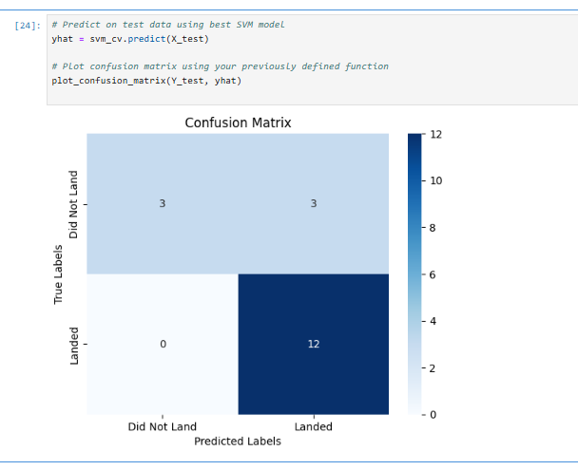
Confusion Matrix
Show the confusion matrix of the best performing model with an explanation

Slide 45
Conclusions
Higher payload mass does not guarantee mission success, but certain booster versions like F9 B5 tend to perform better with heavier payloads.
Mission success rates generally improved over time, with increased flight numbers indicating better performance and reliability.
Launch success is influenced by orbit type, with LEO, ES-L1, GEO, and SSO showing higher success rates than orbits like GTO.

Slide 46
Appendix
Include any relevant assets like Python code snippets, SQL queries, charts, Notebook outputs, or data sets that you may have created during this project

Slide 47


